Slide 1
Personas in HCI
Presented and prepared by:
Muhammad Yahya (02-131212-003)
Eima Nasir (02-131212-020)
Kashan Riaz (02-131212-075

Slide 2
Table of contents
01
02
03
04
Introduction
Purpose of Persona
Supported Features
Persona Creation Process

Slide 3
Table of contents
05
06
07
08
Evaluating Effectiveness
Example UI Elements
Likes/Dislikes in Personas
Future trends in Persona

Slide 4
01
Introduction to Personas
Prepared By : Muhammad Yahya

Slide 5
Personas
Personas are fictional characters created to represent different user types within a targeted demographic, illustrating how they might use a site, brand, or product. Personas are one of the outcomes of market segmentation where marketers use the results of statistical analysis and qualitative observations to draw profiles, giving them names and personalities to paint a picture of a person that could exist in real life.

Slide 6
Personas
What Does Personnas Represent ?
What Are Personnas Based On ?
Personas represent the similarities of consumer groups or segments By embodying specific demographical behaviors, needs, and goals.
Personas are based on demographic and behavioral information collected from users, qualitative interviews, and participant observation.

Slide 7
Personas
Why We Need Personas ?
Personas is outcome of market segmentation where marketers use the results of statistical analysis and qualitative observations to draw profiles, giving them traits and personalities to paint a picture of a person that could exist in real life using our products or services.

Slide 8
History of Personas
Alan cooper a software developer, proposed the concept of a user persona. in 1983 he became engaged with how a specific rather than generalized user would use and interface with the software. Cooper outlined the general characteristics, uses and best practices for creating personas, recommending that software be designed for single archetypal users.

Slide 9
Types of Personas
Primary Personas
Secondary Personas
The main user type that the product is primarily designed for it . It Represents the most critical user group whose needs and goals must be met for the product to succeed.
Example: For a project management tool, a primary persona could be a project manager who needs to organize tasks and collaborate with team members.
Users who are not the primary focus but still interact with the product and have significant needs. They have different goals and needs than the primary personas but still require consideration in the design process.
Example: For the same project management tool, a secondary persona could be a team member who needs to track their tasks and deadlines.

Slide 10
Types of Personas
Exclusionary Personas
Customer Personas
User types that the product is not designed for or who are not intended to be served. It Helps in understanding which user groups to avoid and prevents the design from trying to cater to everyone, which can dilute focus.
Example: For a high-end fashion brand, a negative persona might be a budget-conscious shopper who prioritizes cost over style and exclusivity.
Represent the actual buyers of the product, especially Focuses on the purchasing behavior, budget constraints, and decision-making process.
Example: For enterprise software, a customer persona could be a Chief Technology Officer (CTO) who makes purchase decisions based on budget and technical requirements.
.

Slide 11
Types of Personas
User Personas
Proto Personas
Early-stage, hypothetical personas based on assumptions and initial research. Used when detailed user data is not yet available, often created from brainstorming sessions with stakeholders.
Example: In the initial stages of developing a new educational tool, a proto-persona might be a high school teacher interested in innovative teaching methods.
Focus on the end-users who will be using the product regularly. Detailed depiction of user behavior, needs, and points related to the use of the product.
Example: For a fitness app, a user persona could be a fitness enthusiast who uses the app to track workouts and monitor progress.

Slide 12
Types of Personas
Served Personas
Advisory Personas
Reflect the user groups who directly interact with and benefit from the product. Focuses on the specific benefits and use cases that the product addresses.
Example: For a customer service software, a served persona could be a customer support agent who needs efficient tools to manage and resolve customer queries.
Represent users who influence the use or purchase of the product but do not directly use it. advisory personas have significant input in decision-making processes.
Example: For a school management system, an advisory persona could be a school administrator who recommends software to the school board..

Slide 13
02
Purpose of Personas
Prepared By : Muhammad Yahya

Slide 14
Purpose of Personas
Use Centric Design
Improved Communication
Personas help designers and developers understand and empathize with the end-users.
They ensure that the design process is focused on meeting user needs and preferences.
This leads to creating more intuitive and user-friendly products.
Personas provide a clear and shared understanding of target users among all stakeholders.
They serve as a reference point during discussions and decision-making processes.
This alignment helps keep the project team on the same page regarding user goals.

Slide 15
Purpose of Personas
Focused Product Development
Focused Product advertisement
Customize advertisements to align with the interests and preferences of each persona, ensuring relevance and resonance.
Choose advertising channels that are frequented by each persona, maximizing exposure and engagement.
Utilize persona insights to optimize ad placement, messaging, and visuals for maximum impact and effectiveness.
Personas help prioritize features and functionalities based on user needs and goals.
They guide the allocation of resources towards the most impactful areas.
This results in a more efficient development process and a product that better meets user expectations.

Slide 16
Purpose of Personas
Enhanced User Experience
Personalized Support Solution
assistance to customers based on their specific needs and preferences.
Implement self-service options and FAQs to empower users to find solutions independently.
Train support staff to understand the characteristics and behaviors of different customer segments, enabling them to provide personalized assistance effectively.
Design user interfaces that are intuitive, easy to navigate, and visually appealing.
Personalize user experiences based on individual preferences and behaviors.
Gather user feedback through surveys and usability testing to identify areas for improvement and enhance overall satisfaction.

Slide 17
03
Persona Creation Process
Prepared By : Muhammad Yahya

Slide 18
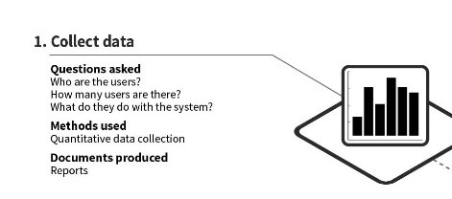
Persona Creation Process

Slide 19
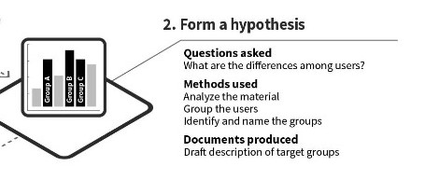
Persona Creation Process

Slide 20
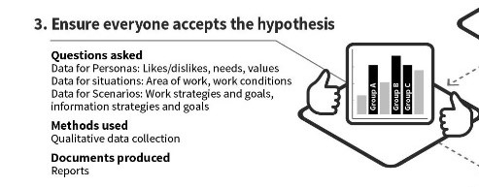
Persona Creation Process

Slide 21
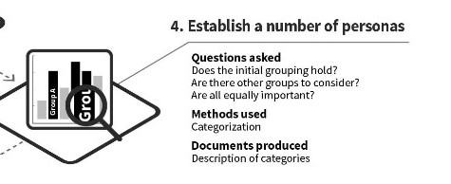
Persona Creation Process

Slide 22
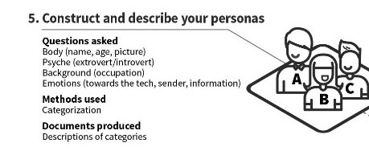
Persona Creation Process

Slide 23
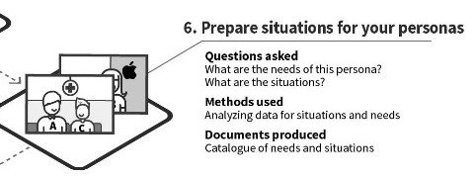
Persona Creation Process

Slide 24
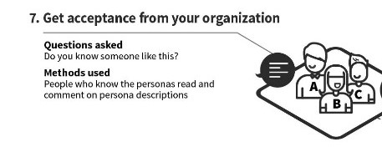
Persona Creation Process

Slide 25
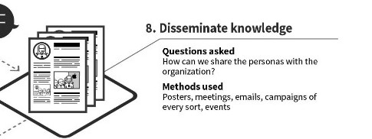
Persona Creation Process

Slide 26
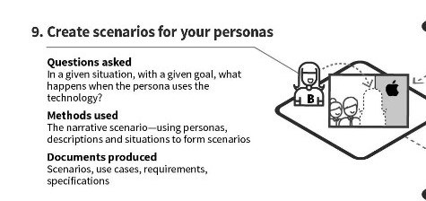
Persona Creation Process

Slide 27
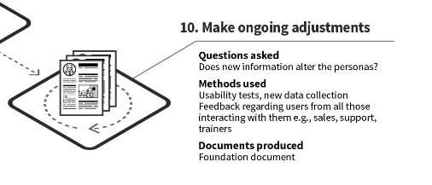
Persona Creation Process

Slide 28
04
Supported Features
Personas in HCI make sure that the design and development process stays user-focused by utilizing these features, which improves the product's overall usability and efficacy.

Slide 29
01
02
User-centric Design:
Enhanced Communication:
Focus on Real Users: Personas ensure that the design process remains centered on real user needs and behaviors.
Empathy Building: They help team members build empathy with the users by providing a tangible representation of them.
Common Language: Personas create a common language among stakeholders, designers, and developers, facilitating better communication.
Scenario Creation: They aid in developing user scenarios and stories that illustrate how users interact with a system.

Slide 30
03
04
Improved Design Decisions:
Behavior Representation:
Goal-Driven Design: Personas help in making design decisions that align with user goals and motivations.
Feature Prioritization: They assist in prioritizing features and functionalities that are most relevant to the target users.
Behavioral Insights: Personas encapsulate key behavioral traits, helping to predict how users might interact with a system.
Problem Identification: They help in identifying potential problems and pain points users may encounter.

Slide 31
05
06
Inclusivity and Accessibility:
Design Validation:
Diverse Representation: Personas can represent diverse user groups, including those with disabilities, ensuring inclusivity in design.
Accessibility Considerations: They highlight the need for accessibility features and compliance with accessibility standards.
Usability Testing: Personas can be used as a reference during usability testing to validate whether the design meets user needs.
Iteration and Feedback: They facilitate iterative design and gathering feedback based on specific user archetypes.

Slide 32
07
08
Marketing and Product Strategy:
Educational and Training Tools:
Target Audience Identification: Personas help in identifying and understanding the target audience for marketing strategies.
Alignment with Business Goals: They ensure that the product strategy aligns with both user needs and business objectives.
Onboarding New Team Members: Personas serve as educational tools for onboarding new team members, helping them quickly understand user needs.
Training Scenarios: They are used in training scenarios to simulate real user interactions and challenges.

Slide 33
05
Evaluating Effectiveness of Personas

Slide 34
Define your success criteria
Clarify Objectives and Outcomes: Identify the primary goals and desired outcomes of your design project.
Establish Measurement Methods: Decide on methods and metrics for measuring persona effectiveness.
Align with Business Goals: Ensure personas reflect and support broader business objectives.
Set Success Criteria and Metrics: Define benchmarks to evaluate the accuracy, relevance, and impact of personas.

Slide 35
Collect feedback and data
Collect Feedback and Data: Gather input from stakeholders, users, and team members.
Use Various Methods: Employ surveys, interviews, tests, analytics, and reviews.
Stakeholder Feedback: Ask stakeholders how well personas match their expectations and vision.
User Feedback: Ask users how accurately personas reflect their reality and preferences.

Slide 36
Analyze and Compare
Analyze Feedback and Data: Review collected information in line with success criteria.
Utilize Tools: Employ spreadsheets, charts, dashboards, and reports for organization.
Comparison with Success Criteria: Compare findings against defined success metrics.
Use of Key Performance Indicators (KPIs): Assess persona performance against KPIs like conversion rates, retention rates, satisfaction scores, and usability metrics.

Slide 37
Identify Gaps and Opportunities
Analysis for Patterns and Trends: Look for patterns, trends, and discrepancies in feedback and data.
Insights for Refinement: Identify insights to refine and update user personas.
Discovering User Needs: Determine features, functions, or benefits valued or lacking in personas.
Exploring New Segments and Behaviors: Find new segments, behaviors, or scenarios not covered by personas.

Slide 38
Implement and Iterate
Implement Changes: Adjust personas based on findings.
Test with Stakeholders, Users: Validate updates with relevant parties.
Monitor Impact: Track results and adjust as necessary.
Dynamic Nature: Understand personas evolve over time.
Continuous Updates: Ensure ongoing relevance and accuracy.

Slide 39
06
Example User Interface(Personas)
Presented by Kashan Riaz and Eima Nasir

Slide 40
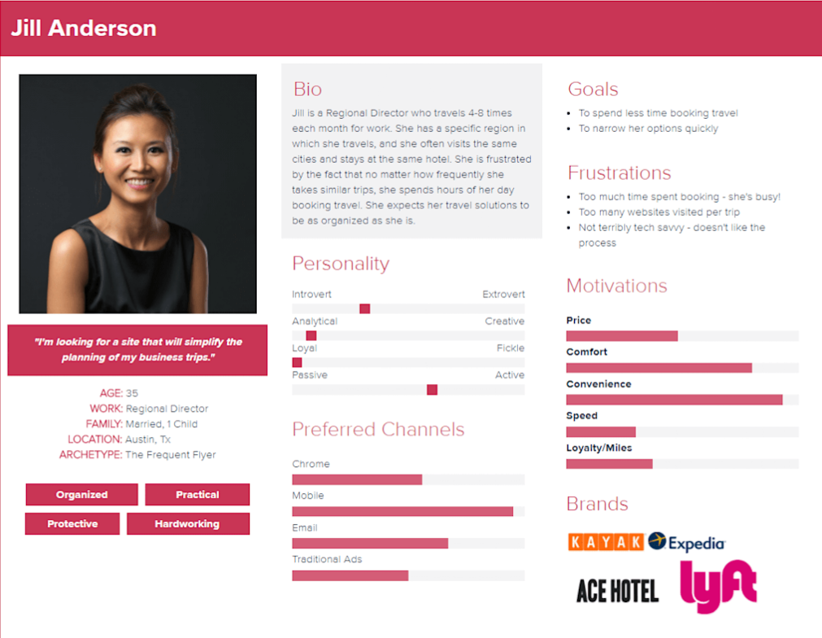

Slide 41
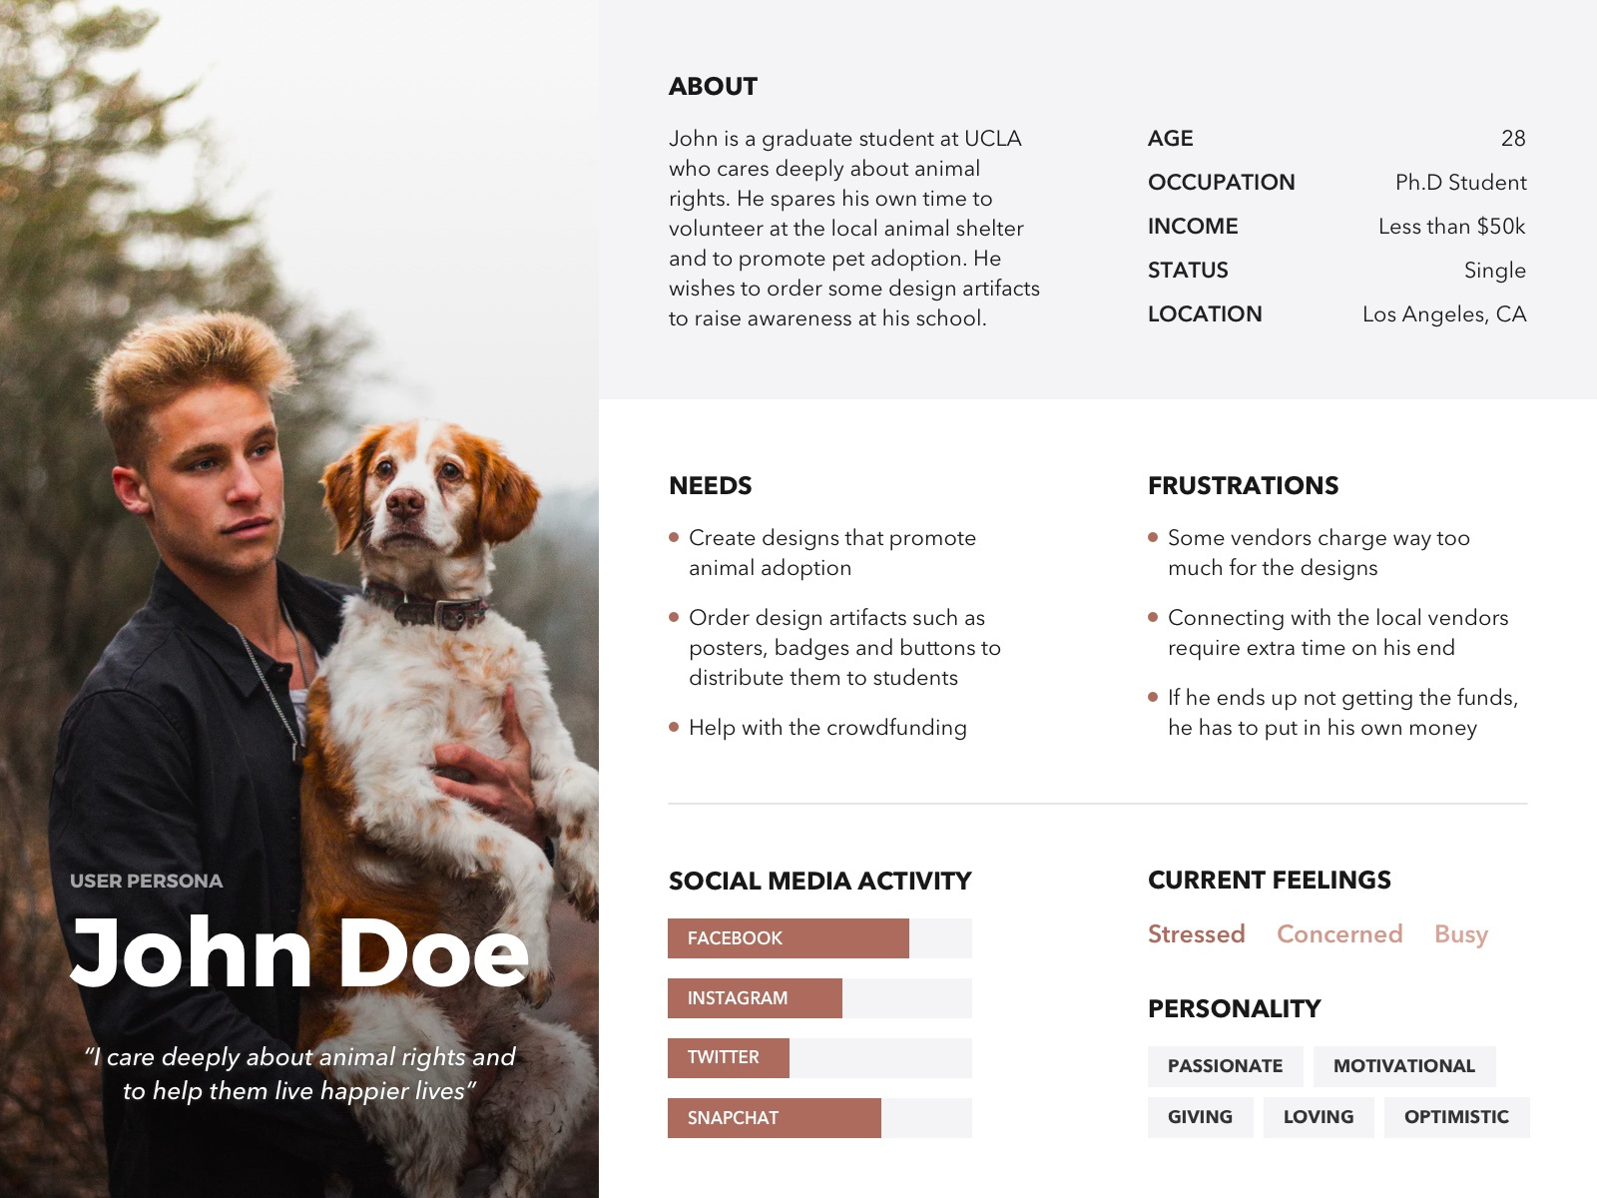

Slide 42
07
Advantages and Disadvantages of Personas
Presented by Kashan Riaz
02-131212-075

Slide 43
Advantages (Likes)

Slide 44
Enhanced User Understanding
Empathy
Focus
Personas help designers and developers empathize with users by creating detailed, relatable representations of their target audience.
They ensure the design process remains user-focused, preventing designers from making assumptions based on their own preferences.

Slide 45
Guided Decision Making
Prioritization
Scenarios
Personas help prioritize features and functionalities based on the needs and behaviors of target users.
They facilitate the creation of realistic user scenarios and use cases, enhancing the usability and relevance of the product.

Slide 46
Efficiency in Design
Consistency
Focus on Realistic Goals
Personas provide a reference point that helps maintain consistency across various design stages and decisions.
They keep the design process grounded in reality, reducing the risk of scope creep by focusing on specific user needs.

Slide 47
Disadvantages (Dislikes)

Slide 48
Risk of Oversimplification
Stereotyping
Inflexibility
There's a danger of creating overly simplistic or stereotypical personas that don't accurately reflect the diversity and complexity of real users.
Rigid adherence to personas can lead to inflexible designs that don't accommodate users outside the defined personas.

Slide 49
Quality and Accuracy Concerns
Data Quality
Dynamic Nature
Poorly researched personas based on assumptions or limited data can lead to incorrect design decisions.
Personas might quickly become outdated as user needs and market conditions evolve.

Slide 50
Resource Intensive
Time and Cost
Maintenance
Creating detailed and accurate personas can be time-consuming and costly, requiring substantial user research and analysis.
Keeping personas up-to-date requires continuous effort and resources.

Slide 51
08
Future Trends in Persona Development
Presented by Kashan Riaz
02-131212-075

Slide 52
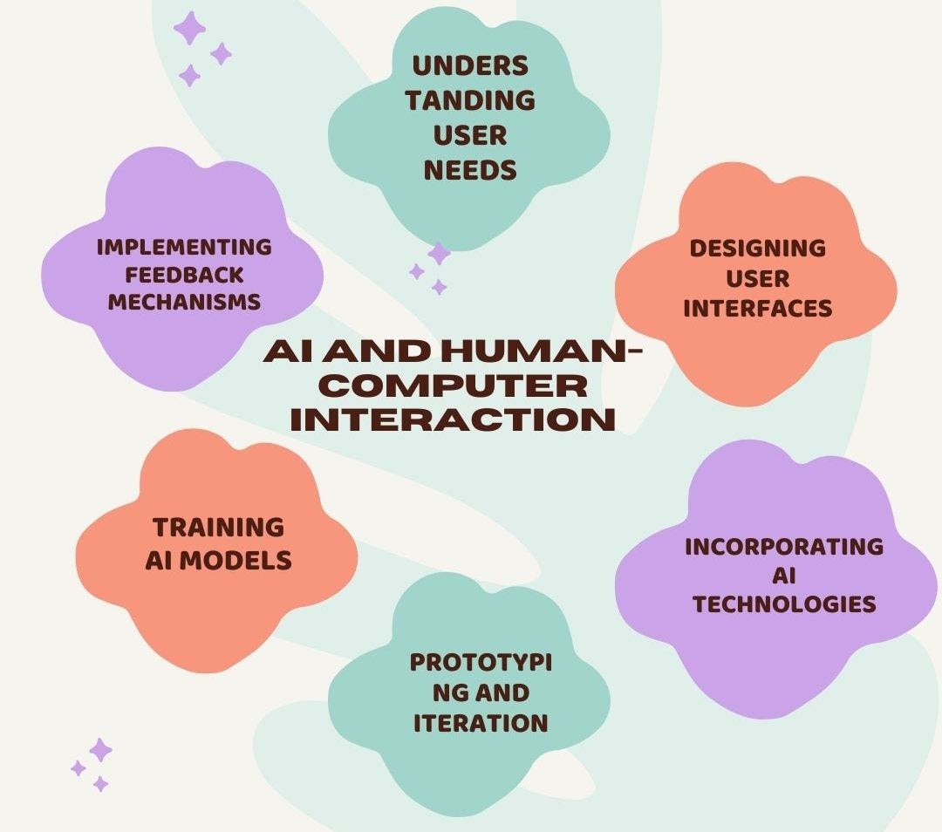
Artificial Intelligence Integration
Artificial intelligence and machine learning can analyze large datasets to generate and refine personas dynamically, reflecting changes in user behavior and preferences over time.

Slide 53
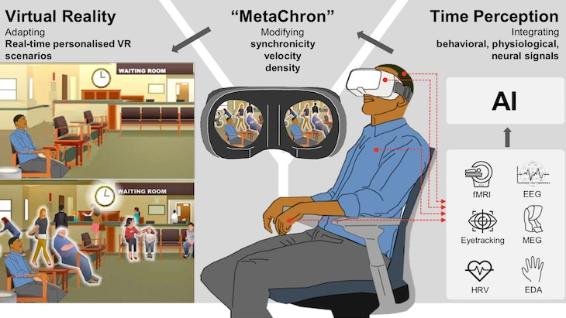
Virtual Reality (VR) and Augmented Reality (AR)
Utilizing VR and AR to create immersive persona experiences, allowing designers to "step into the shoes" of their users and better understand their perspectives.

Slide 54
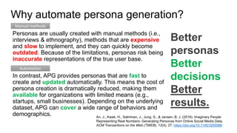
Automation in Design and Development Tools
Incorporating personas directly into design and development tools like Figma, making them easily accessible and usable throughout the design process.
Providing automated insights and recommendations based on personas within design tools, helping to guide designers in making user-centered decisions.

Slide 55
Thanks! Any Questions?

